Slide 1
Capstone Project
The Battle of Neighborhoods

Slide 2

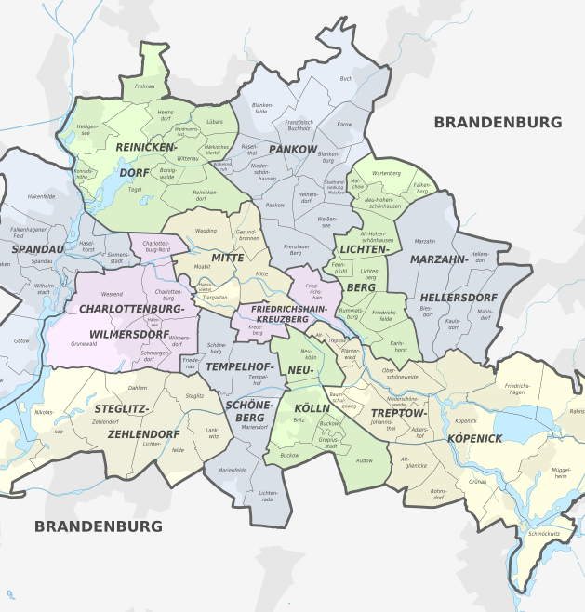
Introduction
New office for a start-up company (http://example.com/) in Berlin The founders of a fast-growing start-up company need new offices as the old offices have become too small. To be attractive for new employees, the founders developed some criteria to identify the ideal location for the new offices.

Slide 3
Business Problem
Finding the best location for the new offices
As a result of the strong growth of their start-up, the founders of example.com are looking for new office space in Berlin.
An attractive location is an important factor in the competition for new talents. The founders wish to be close to universities in order to ensure a close exchange with research and to recruit new candidates as early as possible.
The young employees prefer a good accessibility by public transport, plenty of options to eat and opportunities to exercise after work. After successful financing by venture capital, rental prices are not the critical argument, but could be added later.

Slide 4
Data Description
To find the most attractive place to open a new office the following data is required:
The List of boroughs and neighborhoods of Berlin Source: https://de.wikipedia.org/wiki/Liste_der_Bezirke_und_Ortsteile_Berlins
The coordinates (latitude, longitude) of these Neighborhoods Source: GeoPy
Foursquare:
The universities in each neighborhood
Public transport in each neighborhood (Metro, Tram, Bus)
Diner and snack places in each neighborhood
Gym/Fitness Center in each neighborhood
Each of the neighborhoods is assessed according to the existing requirements. The requirements are weighted according to the importance of the individual preferences in order to calculate a final score.

Slide 5
Methodology
The list of 12 boroughs and 96 neighborhoods of Berlin was compiled from the Wikipedia page.
GeoPy was used for the mapping of the neighborhoods to geographical data
The location data from Foursquare were used for each of the requirements of the company founders.
Each of the neighborhoods is assessed according to the existing requirements
The requirements are weighted according to the importance of the individual preferences in order to calculate a final score.

Slide 6
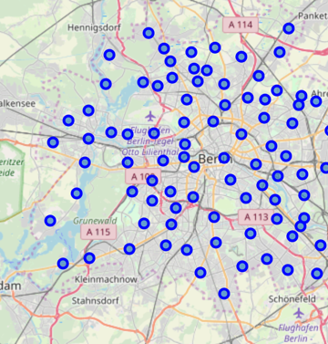
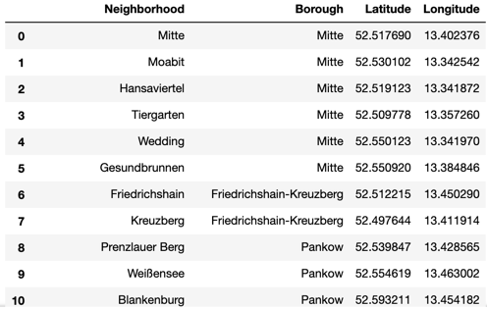
Neighborhoods of Berlin

Slide 7
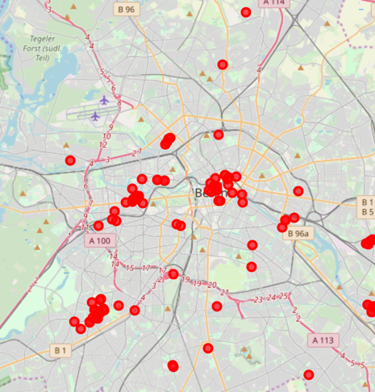
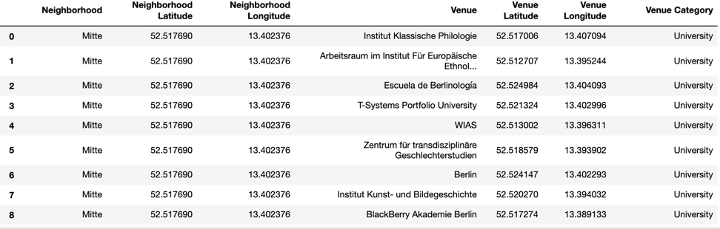
Distribution of Universities

Slide 8
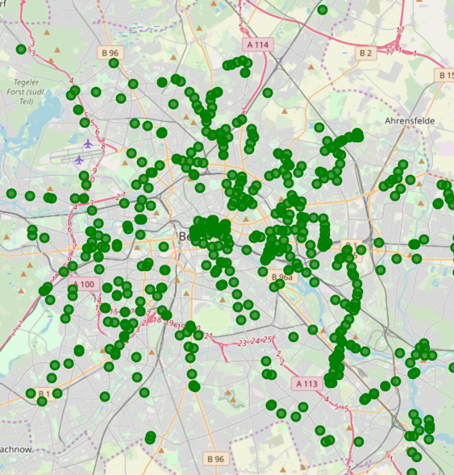
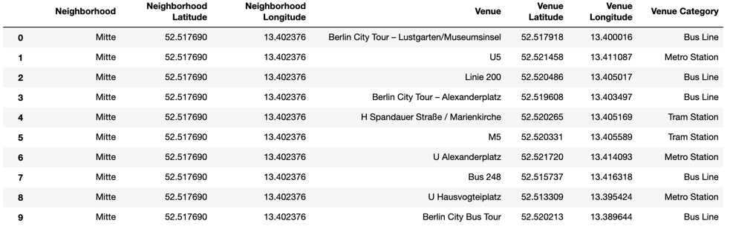
Public transport in each Neighborhood (Metro, Tram, Bus)

Slide 9
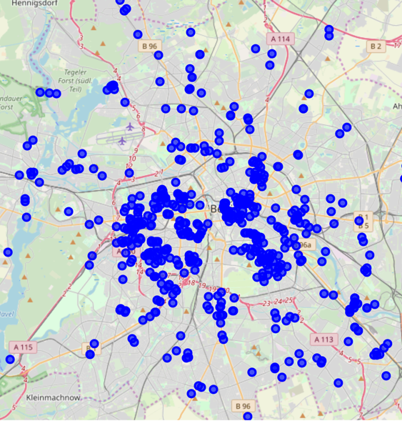
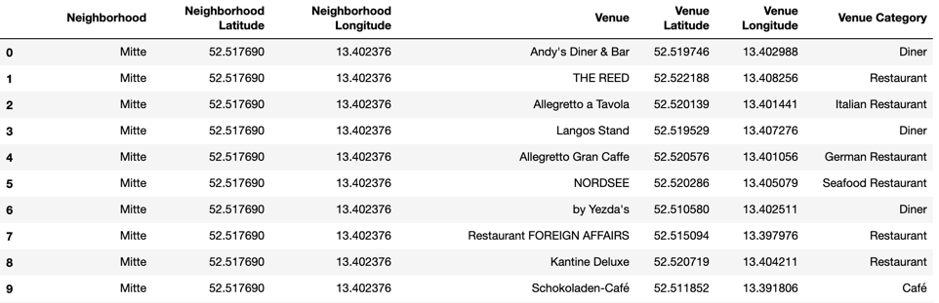
Diner and Snack Places in each Neighborhood

Slide 10
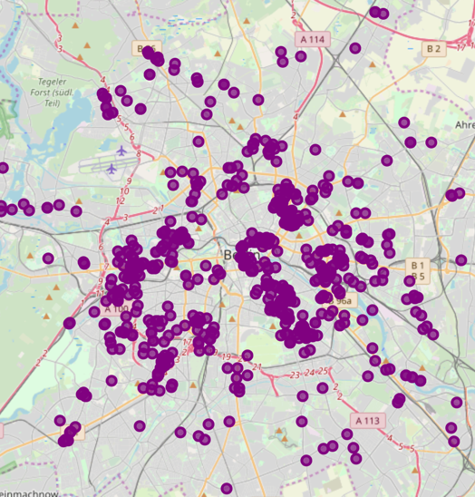
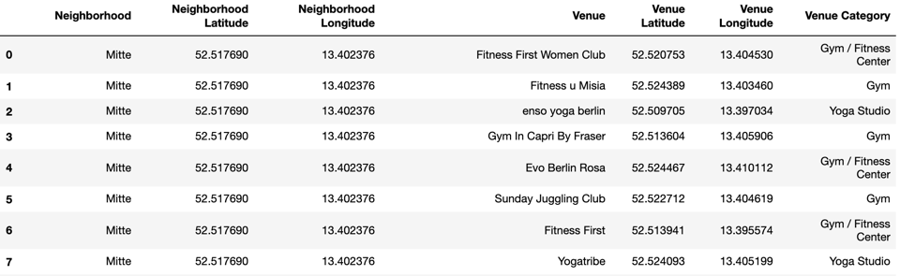
Gym/Fitness Centers in each Neighborhood

Slide 11
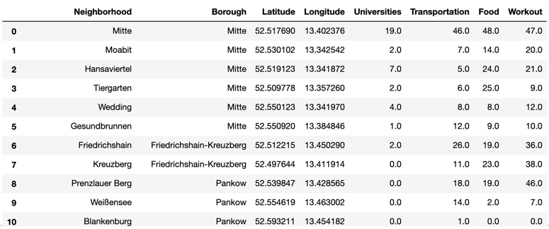
Merging the results of the individual requirements for each neighborhood

Slide 12
Prioritizing the individual requirements
The requirements are weighted according to the importance of the individual preferences in order to calculate a final score.
Universities were given the highest weighting (5)
The founders wish to be close to universities in order to ensure a close exchange with research and to recruit new candidates as early as possible.
Good accessibility by public transport and plenty of options to eat were weighted equally by the employees (3)
Opportunities to exercise after work are nice to have but got a lower priority (1)

Slide 13
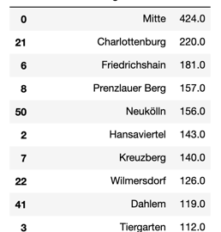
Final Scoring

Slide 14
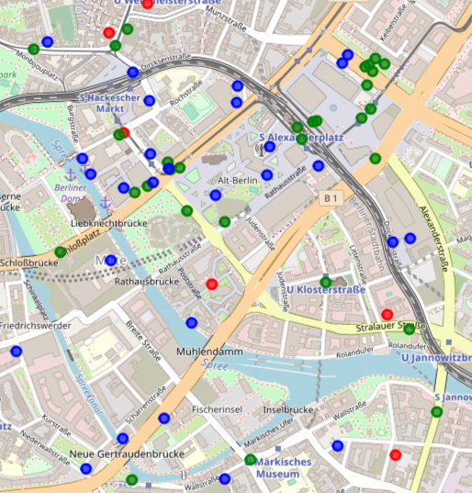
Results
Berlin Mitte is the most attractive place to open a new office, followed by Berlin Charlottenburg and Friedrichshain.
It is not surprising that the city centre offers the best infrastructure but probably also the most expensive rentals.
After successful financing by venture capital, rental prices are not the critical argument, but could be added later to the project if the rental prices become an issue.

